Slide 1
Počítačová grafika III –
Globální osvětlení ve filmové produkci
Jaroslav Křivánek, MFF UK
Jaroslav.Krivanek@mff.cuni.cz

Slide 2
Opakování

Slide 3
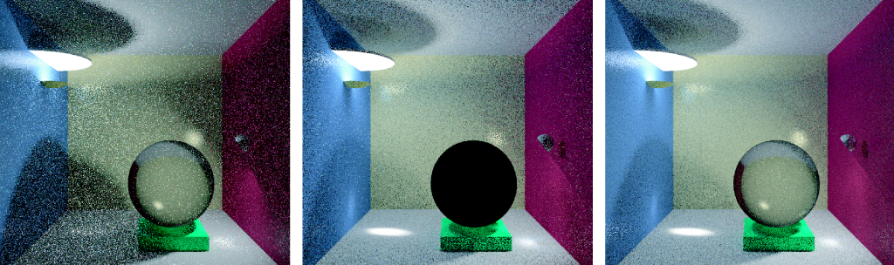
Kvíz 1
© F. Suykens
Path tracing
Light tracing
Bidirectional path tracing
Kvíz: Proč je skleněná koule černá?

Slide 4
Kvíz 2
Proč BPT neumí zobrazit kaustiku na dně bazénu (bodové světlo, pinhole kamera)?

Slide 5
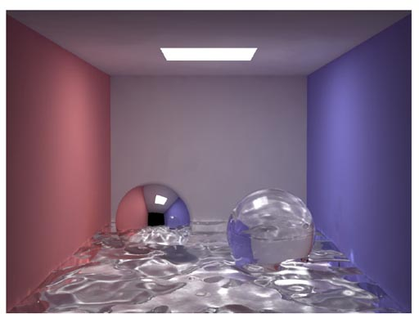
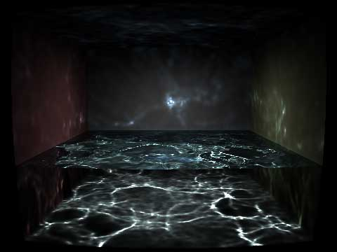
Fotonové mapy – SDS cesty
© H.W.Jensen
© Wojciech Jarosz

Slide 6
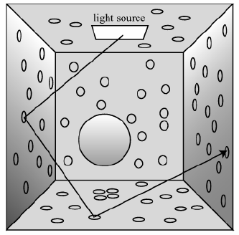
Fotonové mapy – Fáze výpočtu
Rozmístění fotonů
Rendering s využitím
fotonových map

Slide 7
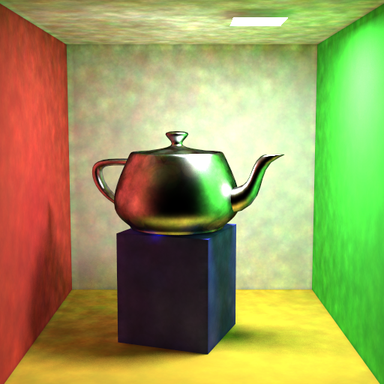
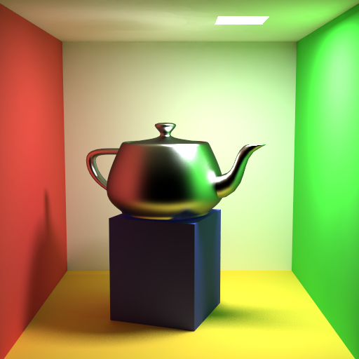

Final gathering?
přímé použití
final gathering
500 – 5000 paprsků
informace v globální mapě příliš nepřesná
nepřesnost v globální mapě se „zprůměruje“

Slide 8
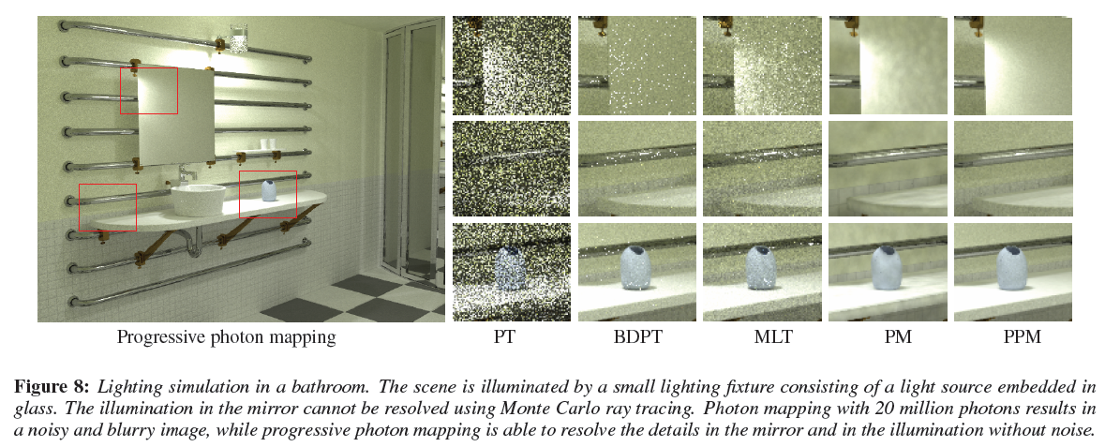
Progresivní fotonové mapy

Slide 9
Globální osvětlení ve filmové produkci

Slide 10
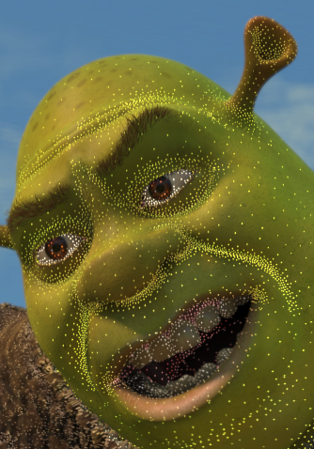
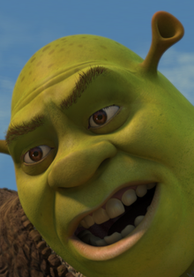
Irradiance caching
Jaroslav Křivánek
Charles University, Prague
Jaroslav.Krivanek@mff.cuni.cz

Slide 11
Motivation
Distribution path tracing (DPT)
Final gathering (FG)
  Estimate illumination integral at a point by tracing many rays (500-5000)
  Costly computation
Irradiance caching accelerates DPT/FG for diffuse indirect illumination

Slide 12
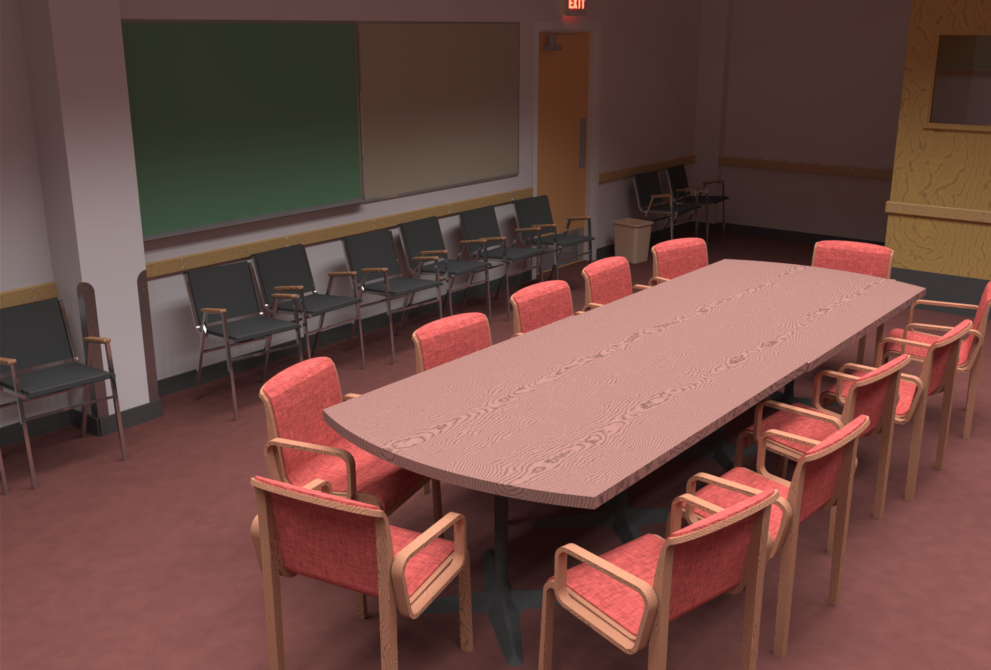
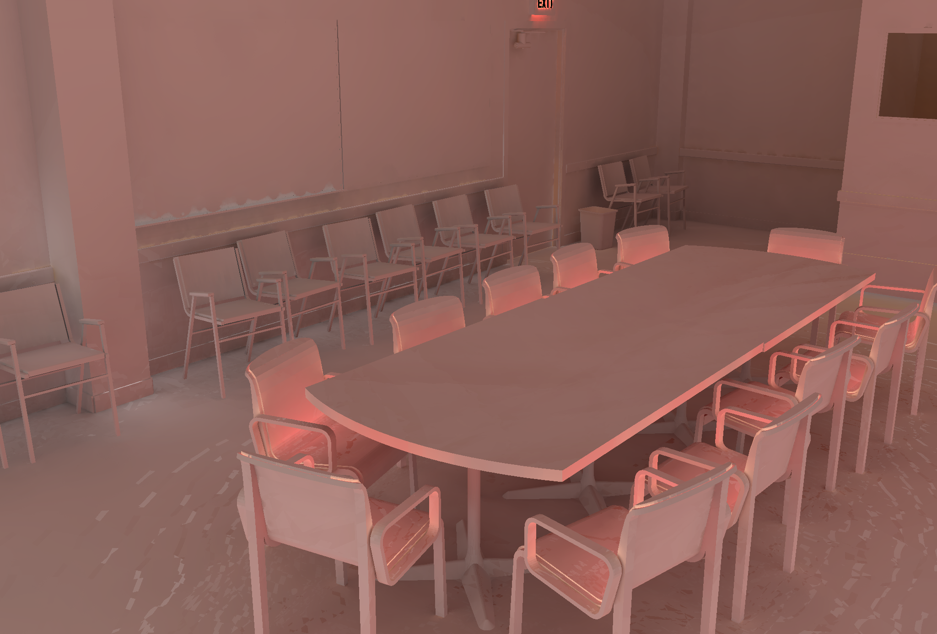
Motivation
Spatial coherence
  Diffuse indirect illumination changes slowly over surfaces
Indirect irradiance – changes slowly

Slide 13
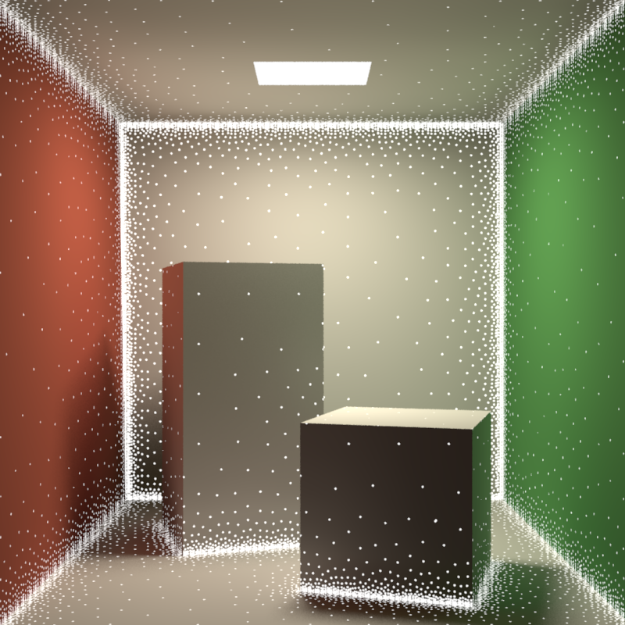
Irradiance caching
Sparse locations for full DRT computation
Resulting irradiance stored in a cache
Most pixels interpolated from cached records
Image credit: Okan Arikan

Slide 14
Irradiance caching
Faster computation of the diffuse component of indirect illumination
Diffuse reflection
  L_{o}(p) = E(p) * ρ_{d}(p) / π
View-independence
  Outgoing radiance independent of view direction
  Total irradiance is all we need => cache irradiance

Slide 15
Irradiance caching
Lazy evaluation of new irradiance values
  Only if cannot be interpolated from existing ones
Example: Values E1 and E2 already stored
  Interpolate at A (fast)
  Extrapolate at B (fast)
  Add new record at C (slow)
B
E2
A
E1
C → E3

Slide 16
Irradiance caching pseudocode
GetIrradiance(p):
  Color E = InterpolateFromCache(p);
  if( E == invalid )
    E = SampleHemisphere(p);
    InsertIntoCache(E, p);
  return E;

Slide 17
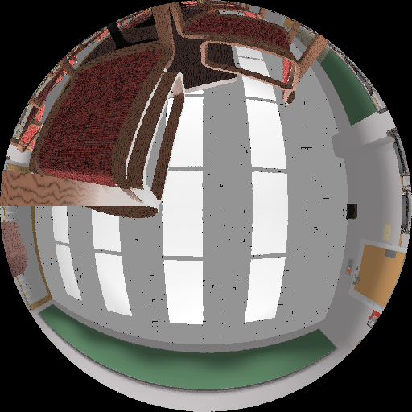
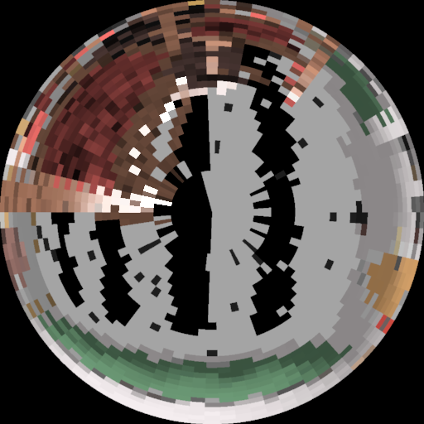
Indirect irradiance calculation
E = SampleHemisphere(p);
Cast 500-5000 secondary rays (user-specified)
Compute illumination at intersection
  Direct illumination only, or
  Path tracing, or
  Photon map radiance estimate, or
  Query in (another) irradiance cache
  No emission taken into account!

Slide 18
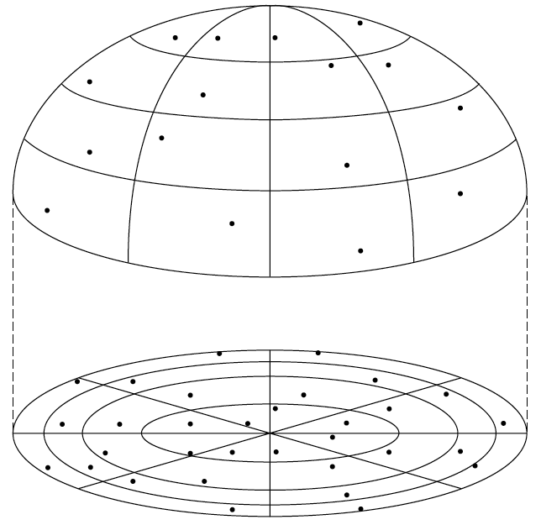
Indirect irradiance calculation
E = SampleHemisphere(p);
Stratified Monte Carlo hemisphere sampling
  Subdivide hemisphere into cells
  Choose a random direction in each cell and trace ray

Slide 19
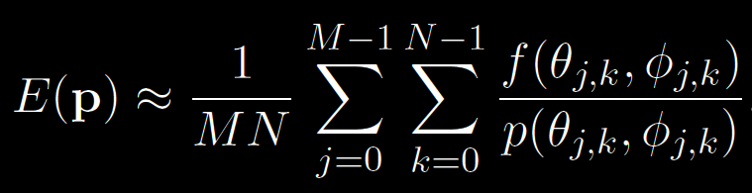
Indirect irradiance calculation
E = SampleHemisphere(p);
Estimating irradiance at p:
General form of the stratified estimator
E(p) = ∫ L_{i}(p, ω_{i}) cosθ_{i} dω_{i}

Slide 20

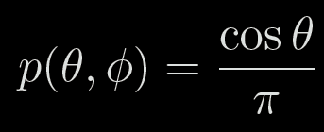
Indirect irradiance calculation
E = SampleHemisphere(p);
For irradiance calculation, the integrand is:
PDF:

Slide 21
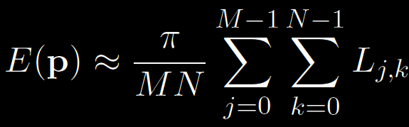
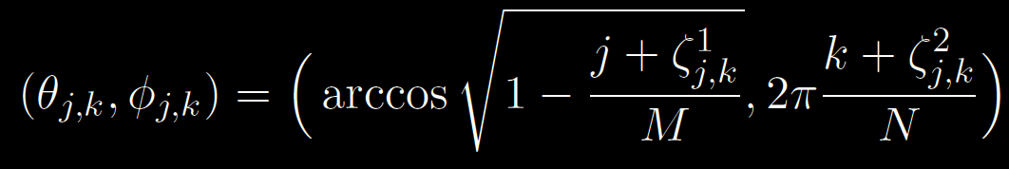

Indirect irradiance calculation
Irradiance estimator for IC:
L_{j,k} … radiance sample from direction:
M, N … number of divisions along θ and φ
… random numbers from R(0,1)

Slide 22
Irradiance caching pseudocode
GetIrradiance(p):
  Color E = InterpolateFromCache(p);
  if( E == invalid )
    E = SampleHemisphere(p);
    InsertIntoCache(E, p);
  return E;

Slide 23
Record spacing
If E(p) changes slowly => interpolate more
If E(p) changes quickly => interpolate less
What is the upper bound on rate of change (i.e. gradient) of irradiance?
Answer from the “worst case” analysis (omitted)

Slide 24
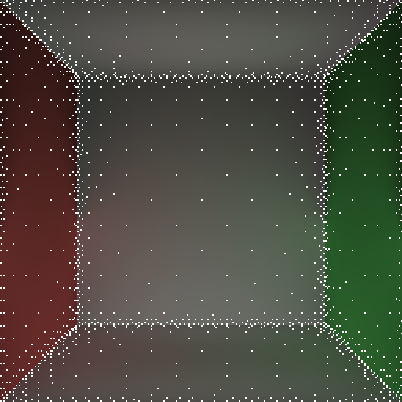
Record spacing
Near geometry
→ dense spacing
  Geometry = source of indirect
  illumination
Open spaces
→ sparse sampling

Slide 25
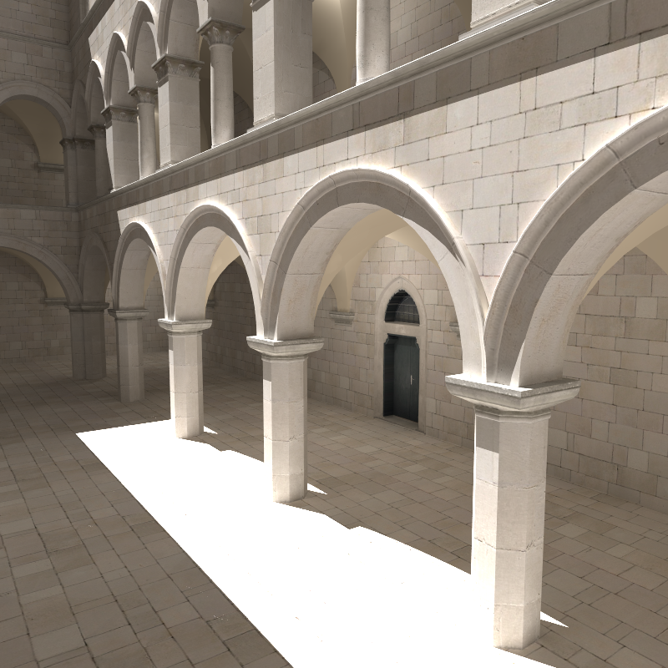
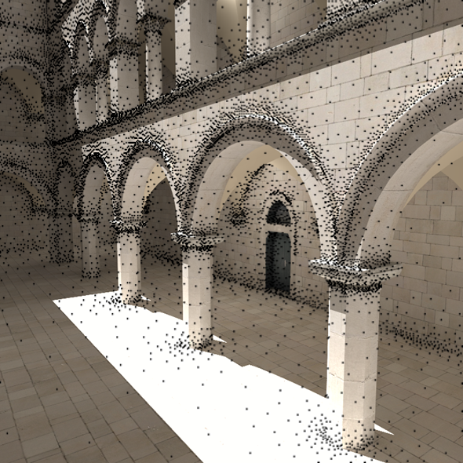
Record spacing

Slide 26
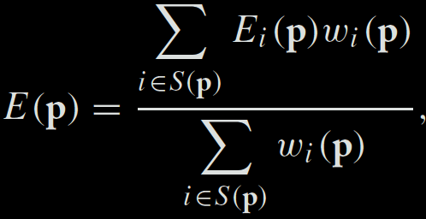

Irradiance interpolation
E = InterpolateFromCache(p)
Weighted average:
Records used for interpolation:

Slide 27
Weighting function
[Tablellion and Lamorlette 04]
p_{i}
R_{i}

Slide 28
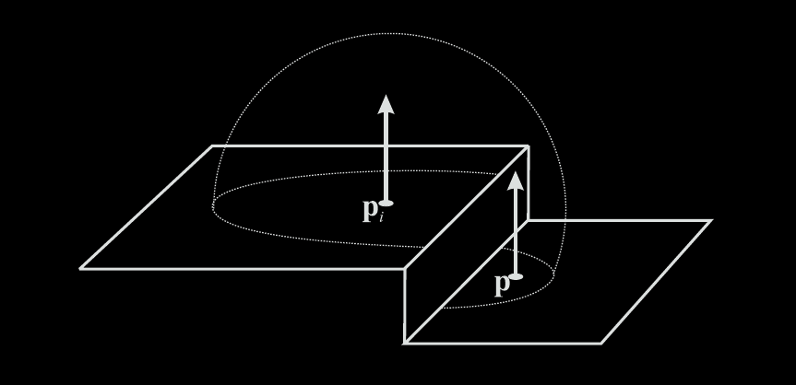
Heuristic “behind” test
Record at p_{i} rejected from interpolation at p if p is “behind” p_{i}

Slide 29
Irradiance caching pseudocode
GetIrradiance(p):
  Color E = InterpolateFromCache(p);
  if( E == invalid )
    E = SampleHemisphere(p);
    InsertIntoCache(E, p);
  return E;

Slide 30
Irradiance cache record
InsertIntoCache(E, p);
Vector3 position
Vector3 normal
float R
Color E
Color dEdP[3]
Color dEdN[3]
Position in space
Normal at `position’
Validity radius
Stored irradiance
Gradient w.r.t. translation
Gradient w.r.t. rotation

Slide 31
Irradiance cache data structure
InsertIntoCache(E, p);
Requirements
  Fast incremental updates
  (records stored on the fly)
  Fast query for all records (spheres) overlapping a given point p

Slide 32
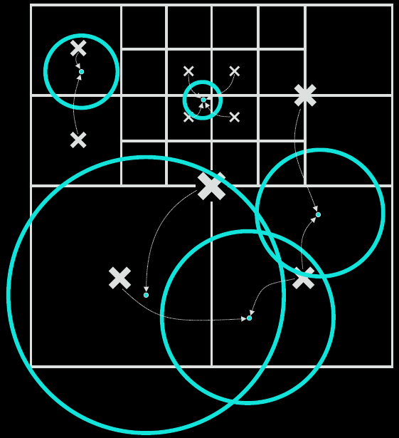
Data structure: Octree
InsertIntoCache(E, p);

Slide 33
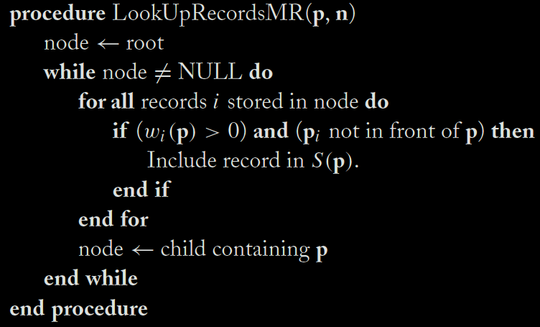
Data structure: Octree
back to … E = InterpolateFromCache(p)

Slide 34
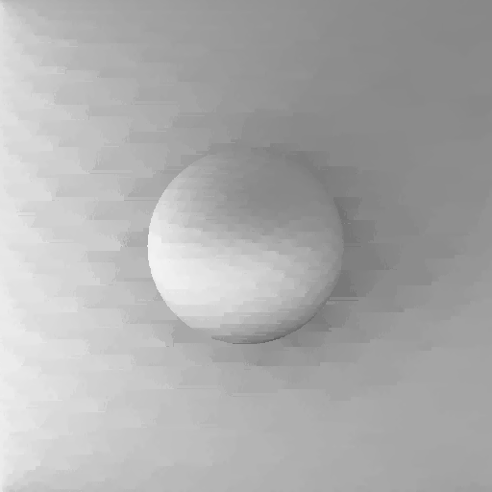
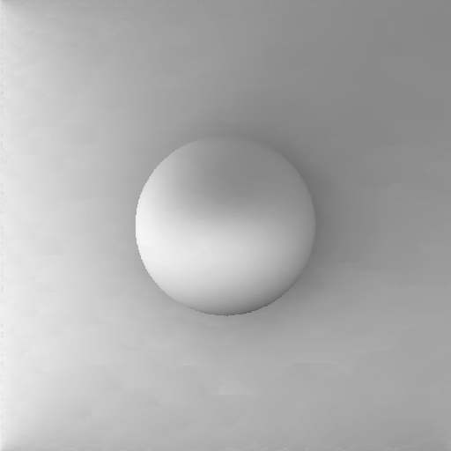
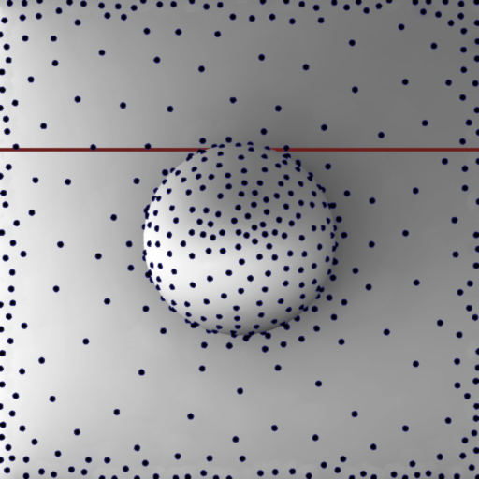
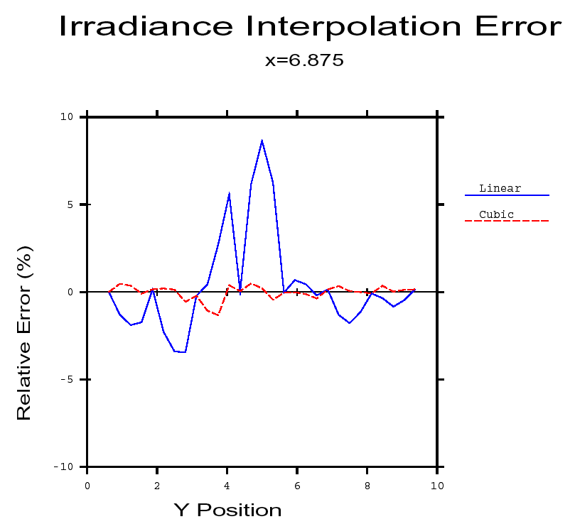
Irradiance gradients
no gradients
with gradients

Slide 35
Irradiance gradients
Essential for smooth interpolation
Calculated during hemisphere sampling
  i.e. no extra rays, little overhead
Stored as a part of the record in the cache
Used in interpolation

Slide 36
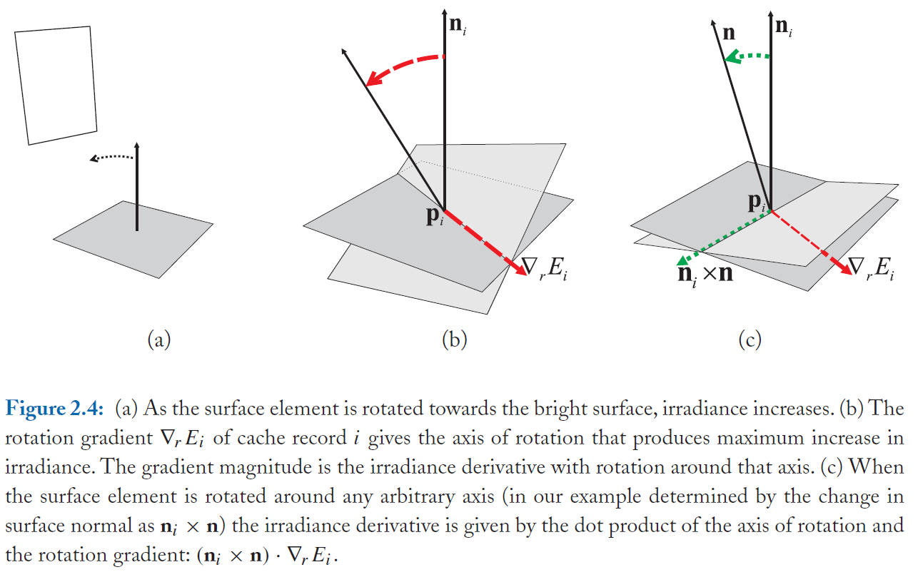
Rotation gradient

Slide 37
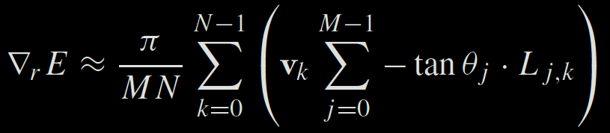
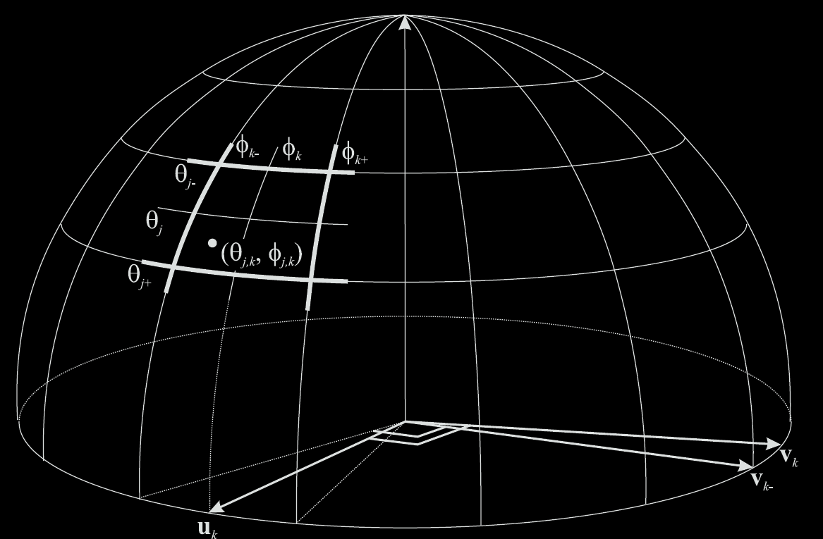
Rotation gradient formula

Slide 38
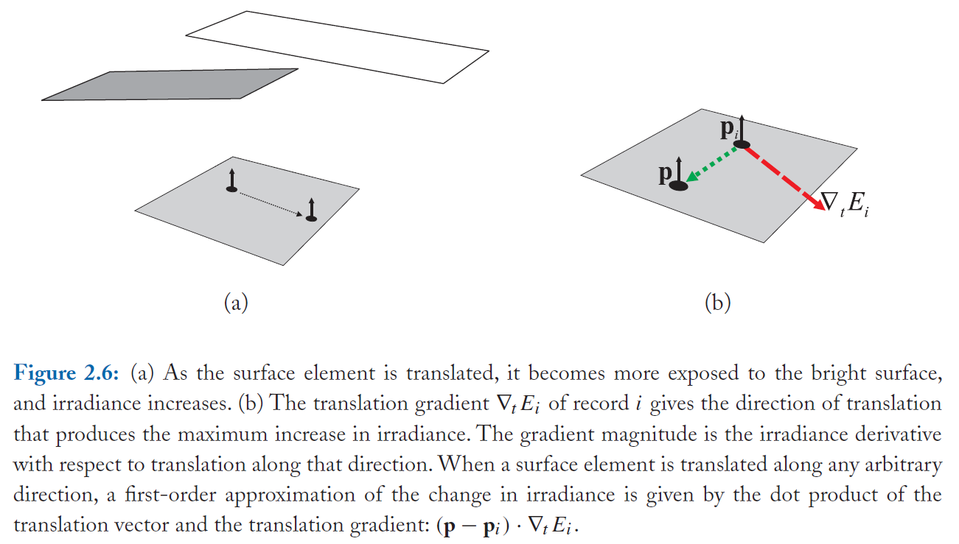
Translation gradient

Slide 39
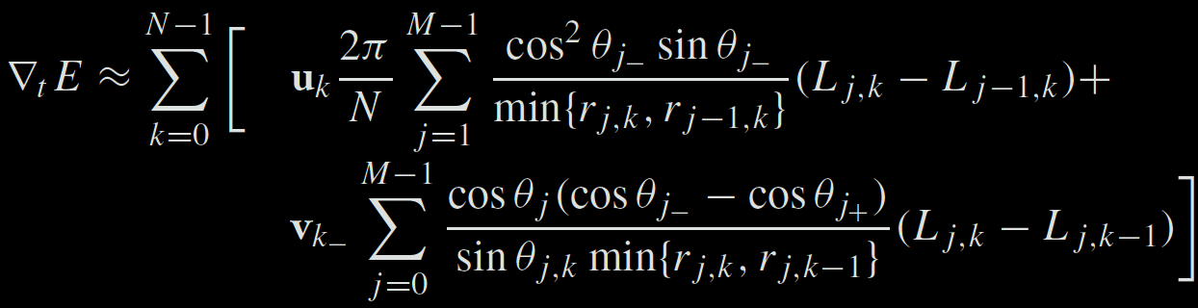
Translation gradient formula
Notes:
To evaluate the translational gradients efficiently and comfortably, it is beneficial to first shoot rays for all hemisphere cell and record the incoming radiance L_{j,k} and the hit distance r_{j,k} in a 2-D table indexed by j and k. With such a table it is then easy to evaluate the sums above.

Slide 40
Irradiance interpolation w/ grads
E = InterpolateFromCache(p)
Weighted average:

Slide 41
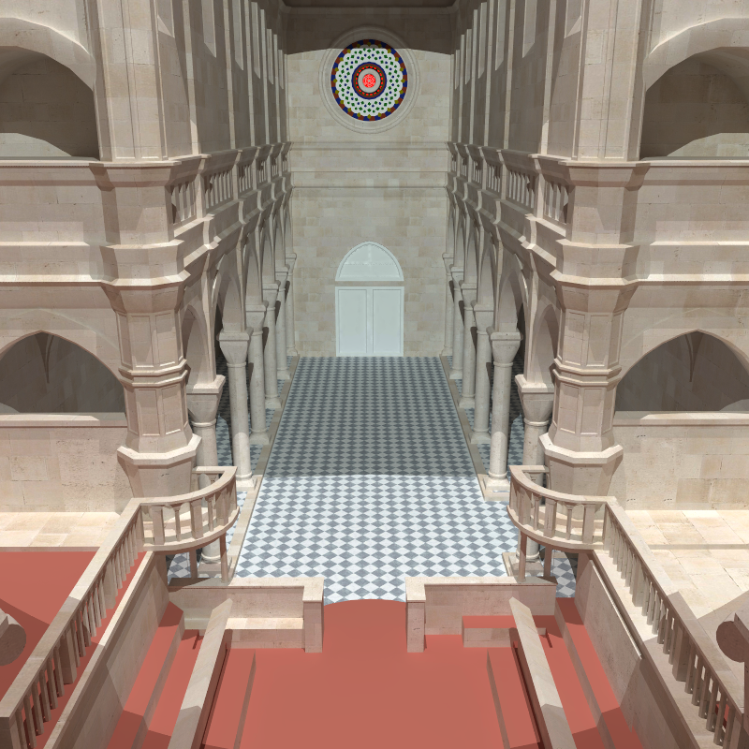
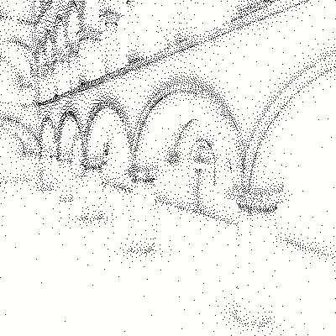
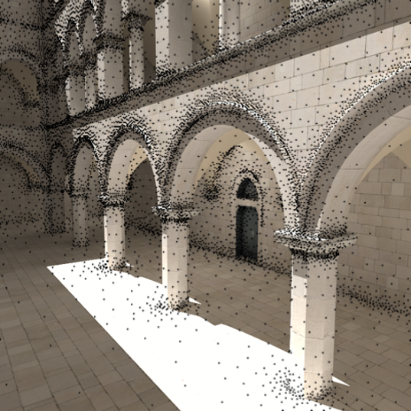
Irradiance caching examples

Slide 42
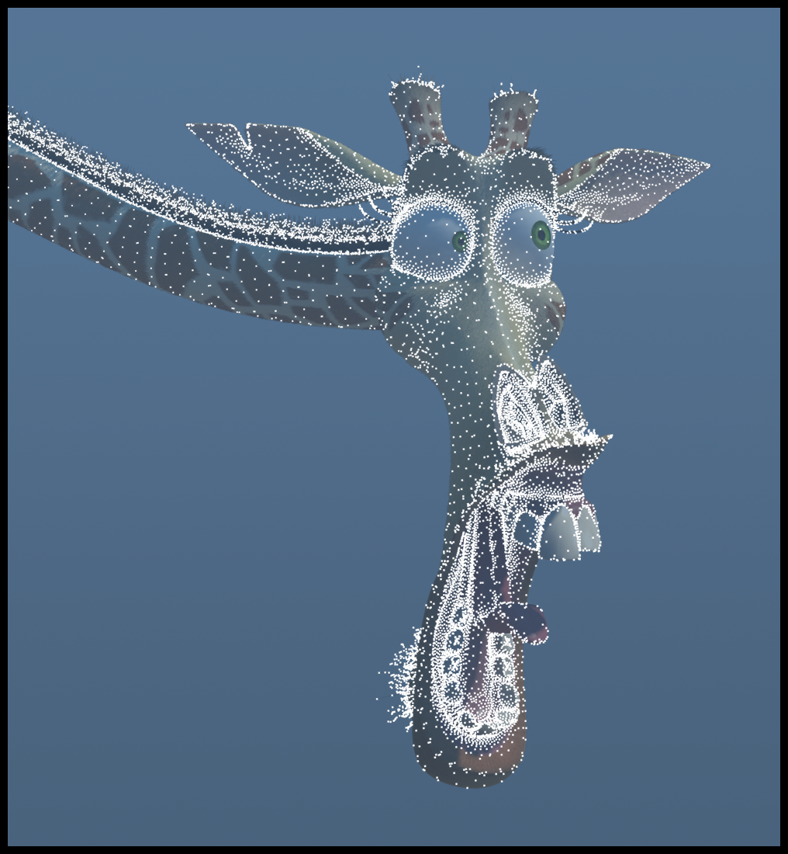
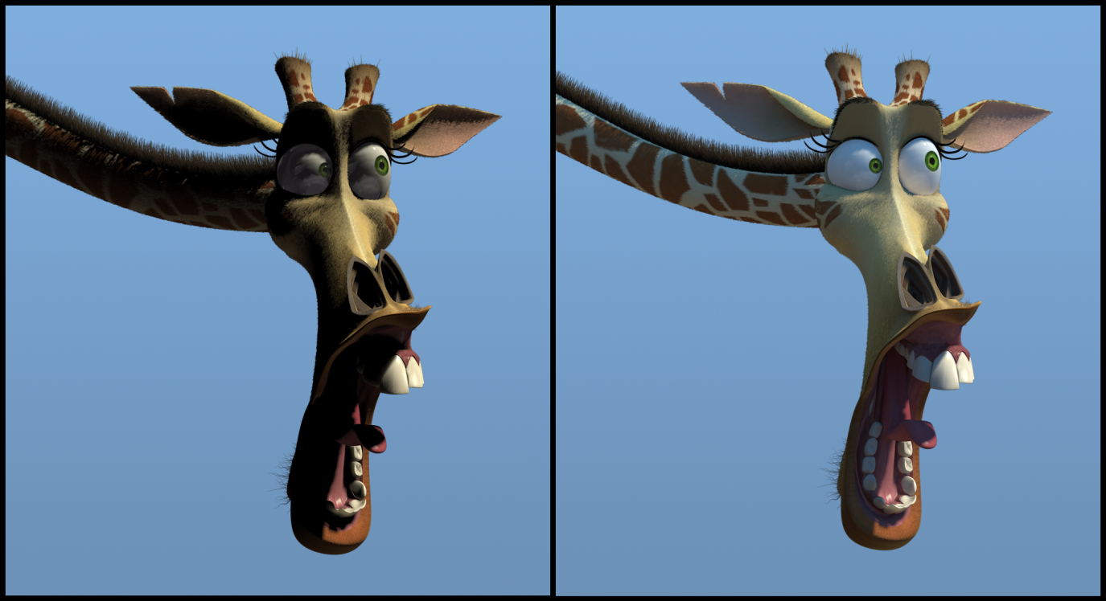
Irradiance caching examples
Image credit: Eric Tabellion, PDI DreamWorks

Slide 43
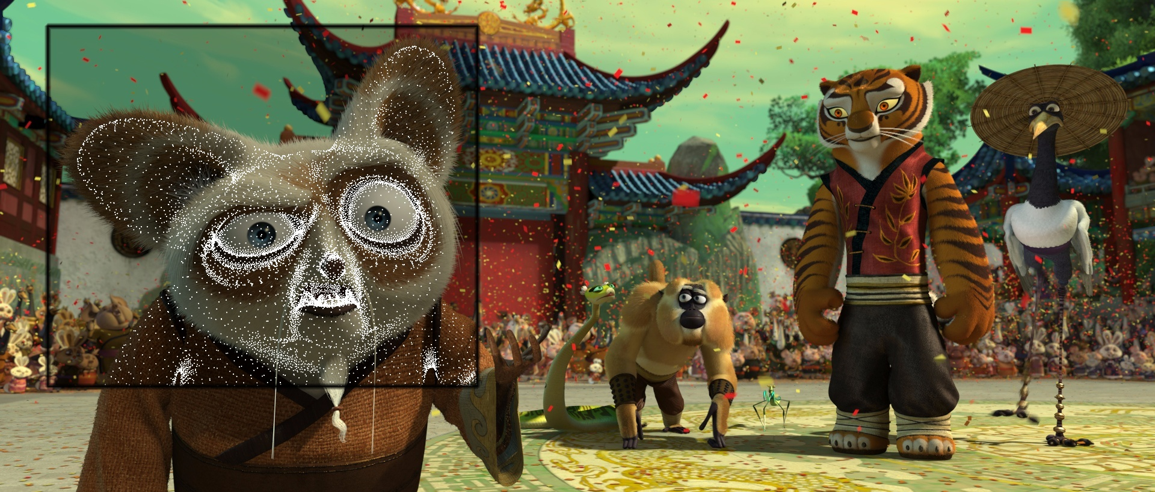
Irradiance caching examples
Image credit: Eric Tabellion, PDI DreamWorks

Slide 44
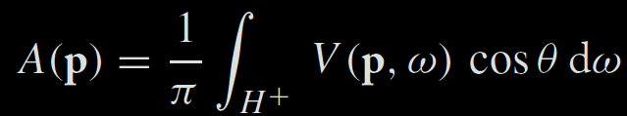
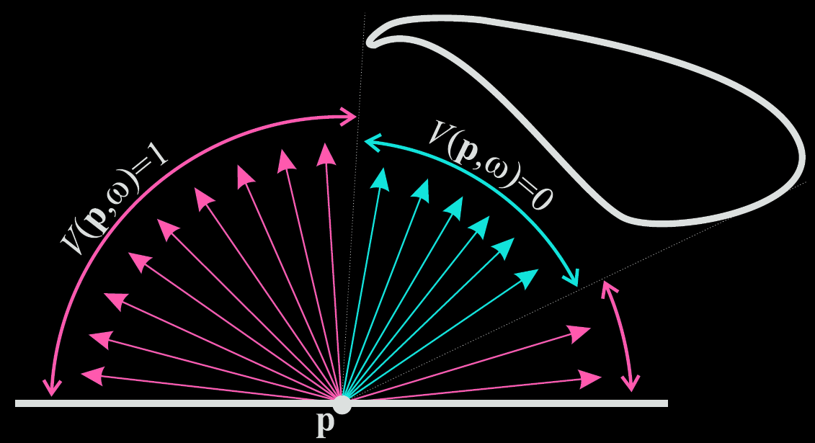
Ambient occlusion

Slide 45

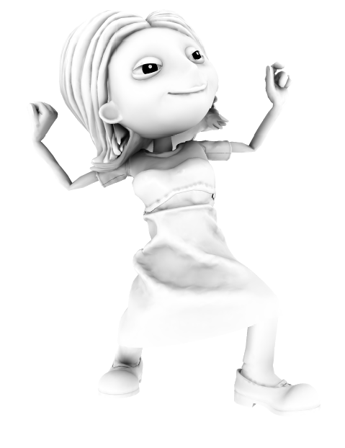
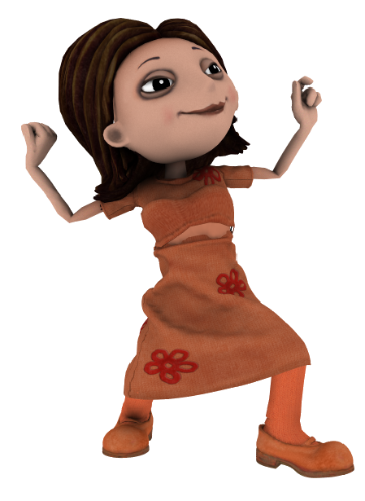
Ambient occlusion
x
=

Slide 46
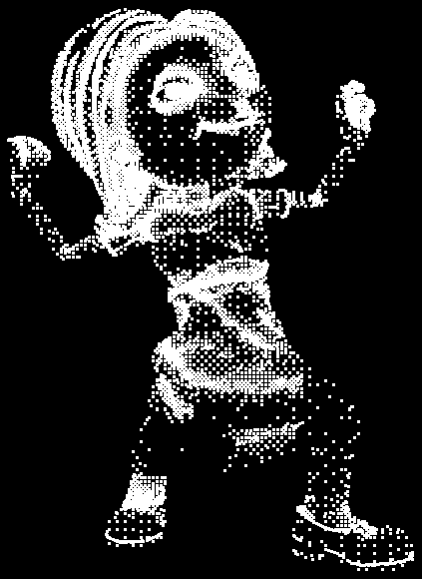
Ambient occlusion caching

Slide 47
Conclusion
Fast indirect illumination of diffuse surfaces
  Sparse sampling & fast interpolation
Biased
Not consistent
Tons of implementation details that I did not discuss here

Slide 48
Further reading
Practical Global Illumination with Irradiance Caching
  SIGGRAPH Course: 2008, Křivánek et al.
  Book, 2009, Křivánek & Gautron
  Both give references to further resources

Slide 49
Bodové globální osvětlení
(Point-based Global Illumination)

Slide 50
Bodové globální osvětlení
Původní myšlenka
  M. Bunnell, “Dynamic ambient occlusion and indirect lighting”, GPU Gems 2
Aplikace pro rendering ve filmu
  P. Christensen, “Point-based approximate color bleeding”, Pixar tech memo #08-01
Real-time implementace (CUDA)
  T. Ritschel et al, “Micro-rendering for scalable, parallel final gathering”, SIGGRAPH Asia 2009

Slide 51
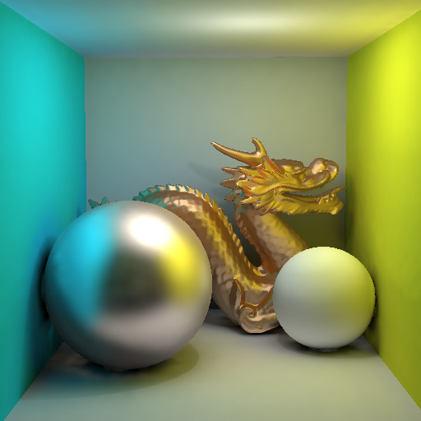
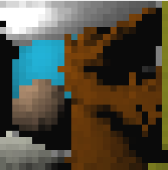
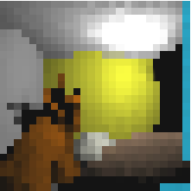
Bodové globální osvětlení
Slide credit: Tobias Ritschel

Slide 52
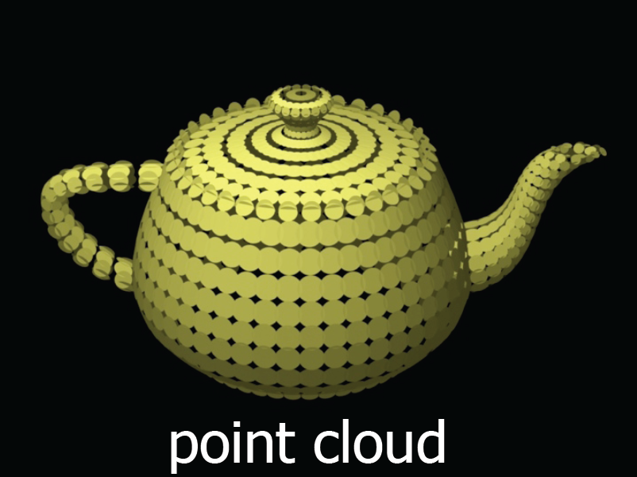

Bodové globální osvětlení
Slide credit: Per Christensen

Slide 53
Materiály
Křivánek et al.: Global Illumination Across Industries, SIGGRAPH 2010 course.
http://cgg.mff.cuni.cz/~jaroslav/gicourse2010/
  Point-based Global Illumination for Film Production
  (Per Christensen, PIXAR)
  Ray Tracing vs. Point-based GI for Animated Films
  (Eric Tabellion, PDI Dreamworks)
Ritschel et al. Microrendering for Scalable, Parallel Final Gathering, SIGGRAPH Asia 2009.
http://www.mpi-nf.mpg.de/~ritschel/Microrendering/

Slide 54
Path Tracing

Slide 55
Materiály
Křivánek et al.: Global Illumination Across Industries, SIGGRAPH 2010 course.
http://cgg.mff.cuni.cz/~jaroslav/gicourse2010/
  Ray Tracing Solution in Film Production Rendering (Marcos Fajardo, SolidAngle)

Slide 56
Co jsme nestihli…

Slide 57
Letem světem
Metropolis Light Transport
Virtuální světla + škálovatelné metody
Předpočítaný přenos radiance
Opticky aktivní média + subsurface scattering
Real-Time GI
Zobrazování vlasů
Modelování vzhledu

Slide 58
Metropolis Light Transport
Aplikace vzorkovací metody Metropolis-Hastings na vzorkování funkce příspěvku světelné cesty
  Mutace cest
[Veach 1997]

Slide 59

(a) Bidirectional path tracing with 40 samples per pixel.
Image credit: Eric Veach

Slide 60

(b) Metropolis light transport with an average of 250 mutations per pixel [the same computation time as (a)].
Image credit: Eric Veach

Slide 61

Metropolis Photon Tracing
Image credit: Toshiya Hachisuka

Slide 62
Instant radiosity (VPL rendering)
[Keller 1997]
Approximate indirect illumination by
Virtual Point Lights (VPLs)
Generate VPLs
Render with VPLs

Slide 63


Předpočítaný přenos radiance

Slide 64

Opticky aktivní média

Slide 65






Subsurface scattering examples
Real
Simulated

Slide 66
Real-time GI
Techniky založené na VPL
Screen-space techniky
Implicitní viditelnost & anti-radiance

Slide 67

Zobrazování vlasů

Slide 68


Modelování vzhledu

Slide 69
Závěr

Slide 70

Research challenges in rendering
Existing algorithms are inherently bad
for some practical scenes
More work to do for rendering researchers

Slide 71
What else in CG
Main general CG conferences
  SIGGRAPH (ACM Transactions on Graphics – TOG)
  SIGGRAPH Asia (ACM TOG)
  Eurographics (Computer Graphics Forum)
http://kesen.realtimerendering.com/

Slide 72
What else in CG
Computational photography
Appearance modeling & capture
Animation (& capture)
Dynamic simulation (hair, cloth, water, smoke, solids…)
Visual perception
Natural phenomena
Non-photorealistic rendering
Sound simulation
Display technology
Interaction technology
Geometry modeling

Slide 73
General challenges in CG
Making CG usable: UI design, collaboration
Robust and efficient lighting simulation
Virtual human
  Hair modeling
  Animation
  Cloth
Managing complexity
  Natural environments etc
Virtual Worlds (shared 3D graphics)
…and more (the above is my random choice of “grand challenges”)

